Slide 1
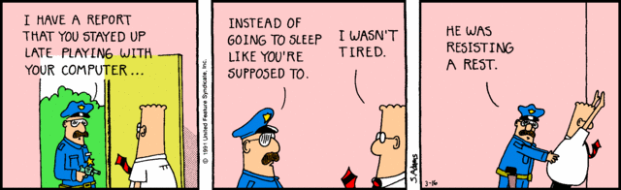
Fatigue Management

Slide 2
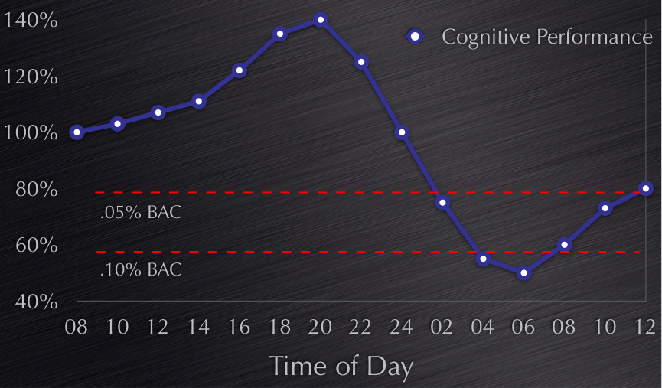
Fatigue v Alcohol
Notes:
After 17 hours awake, you may be as impaired as if you were legally too drunk to drive (BAC .05) and after 24 hours awake, your impairment level matches a blood alcohol level of BAC 0.10 – too drunk to drive.

Slide 3
The Problem
Marine pilotage is a high risk operation that usually operates on a continuous basis.
The machinery that assists in the pilotage can operate ad infinitum.
The human operator however isn’t designed for continuous operations.
This mismatch at the human – machine interface will, if not controlled in a suitable manner, lead to fatigue problems that can have disastrous consequences.

Slide 4
Marine Pilot Fatigue Contributors
Notes:
Shift / Roster: Time of day, Hours of work, Work cycle, Frequency and length of breaks, No. of shift changes, Workday length
Lifestyle: Suitability for shiftwork, Age, sleep disorders, Nutrition, Exercise regime, Ability to manage stress, Illness, Weight, Substance abuse (i.e. alcohol, caffeine)
Outside Influences: Family demands – phone calls, stress, Hours continuously awake, Social activities
Commuting: Distance to / from home, Travelling to come on swing, Jet lag – Time differences from home locations
Nature of Work: Mental load / concentration, Inconsistent sleep patterns, Physical effort, Temperature exposure
Berthing and Departure: Differing work conditions – ship traffic, night, wind, tidal movements, heat, humidity
Sleeping Environment: Air conditioning, Noise, Comfort of sleeping environment, Light control, Length of sleep
Workplace Culture: Support from management to enforce fatigue management measures, Ship movement requirements – terminal pressures, Pilot scheduling and the understanding of fatigue measures around this

Slide 5

The Solution

Slide 6
In Captain Cook’s Time
  Article XXVII of the Kings Regulations and Admiralty Instructions stated that:
  “No person in or belonging to the fleet shall sleep upon his watch, or negligently perform the duty imposed on him, or forsake his station on pain of death”.

Slide 7
A Joint Venture Partnership
There is a Joint Responsibility for Fatigue
Management is responsible for
  Preventing excessive wakefulness periods at work
  Preventing inadequate sleep opportunities between shifts
  Providing clear guidelines on how to manage an insufficient sleep/excessive wake incident
Employees are responsible for
  managing their time away from work to obtain sufficient sleep to ensure that they arrive at work in a state fit for duty.
  Reporting that if, for whatever reason, the above is not possible that there is a potential fatigue risk and to engage in appropriate risk mitigation
Notes:
Because work-related causes of fatigue are largely under the control of the organisation and non work-related factors are controlled by individual employees, both have a responsibility for managing fatigue.
Both employers and employees need to be aware of the risks posed by fatigue on the job, and to take steps to reduce that risk.

Slide 8
Fatigue Risk Management System (FRMS)
The key elements of a FRMS are
  FRMS Policy Document
  Competency based training and education program
  Auditable methodology to ensure a safe level of alertness for staff
  Auditable methodology to ensure compliance with control levels 1- 3 of the fatigue trajectory
  The Fatigue Management Plan
  is a systematic risk based approach to help Pilots assess, manage and report fatigue levels.
  outlines prescribed work and rest hours designed to provide clear boundaries and set expectations.
  outlines how to implement and use fatigue controls
Notes:
THE FMP is therefore a key part of the FRMS. It is the nuts and bolts if you like.

Slide 9
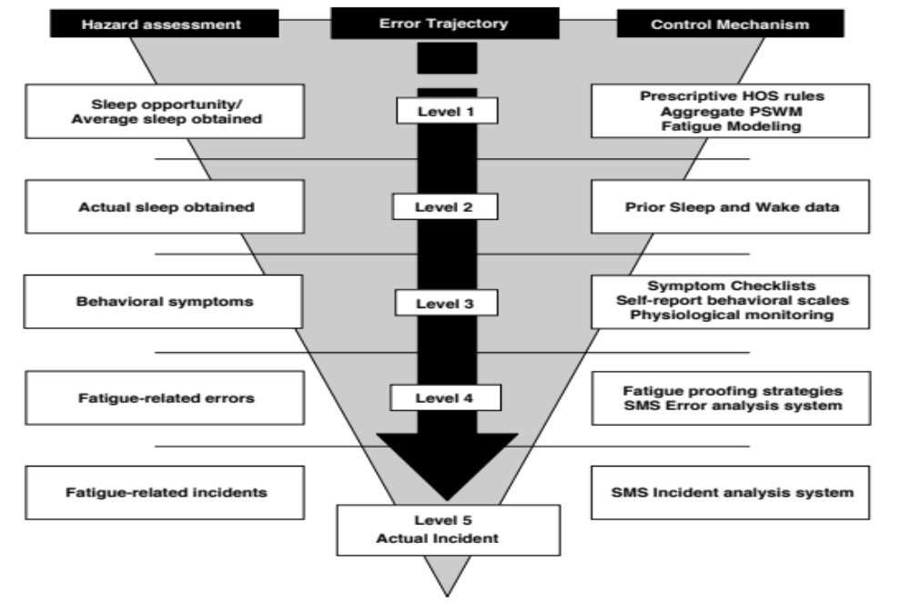
Fatigue Risk Trajectory
Notes:
Fatigue risk trajectory: There are multiple layers that precede a fatigue-related incident for which there are identifiable hazards and controls. An effective Fatigue risk management system should attempt to manage each layer of risk. (Dawson & McCulloch, 2005)

Slide 10
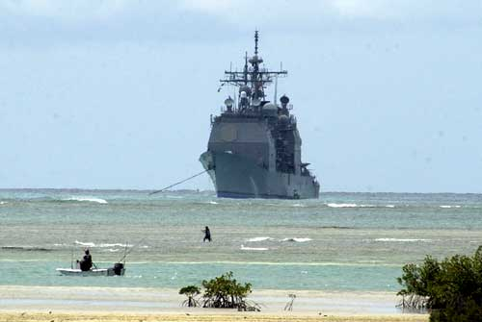
Level 1 Controls

Slide 11
Level 1 Controls
Ensure an adequate sleep opportunity is given
The placement of these opportunities must give due regard to the circadian cycle
These controls are monitored by the use of tools such as
  Prescriptive Rules
  Aggregate PSW Model – FAID, Samn Perrelli
  Fatigue Modelling
The use of Level 1 tools ensures that:
  In theory at least, an adequate opportunity to rest and recover is given
  Unfortunately though, for whatever reasons, an adequate sleep opportunity is not always acted upon and the employee is therefore not adequately rested

Slide 12
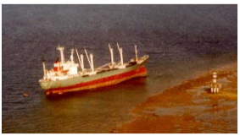
Level 2 Controls

Slide 13
Level 2 Controls
Involve processes for confirming that adequate sleep is in fact obtained.
In general, this is achieved by setting minimum sleep and maximum wake durations using simple mental heuristics or more complex software-based models.
A simple method to determine this is by the use of what is termed the prior sleep – wake model.

Slide 14
Level 2: Prior Sleep Wake Model
Wake-up
Start of Shift
End-of-shift
Sleep
Sleep
Sleep
Work
Sleep
[X] Sleep in prior 24 hours
[Y] Sleep in prior 48 hours
[Z] Prior wakefulness
Fatigue is unlikely to be a problem when X,Y and Z are above task and/or occupationally defined thresholds

Slide 15
Marine Pilot’s Risk Management Decision Tree
PFS | WLS | Mitigating measure
0 | All work is allowed | Fatigue is not indicated. If you feel fatigued, do not work. Contact your supervisor in this case. Be aware of when your score is forecast to move to 1, as defined by the fatigue application. Piloting must occur only with your score below zero.
1 to 5 | No work is advised however, Load Mastering or administration / motor vehicle driving is allowed where necessary. | Assess the requirements and your ability to continue to work. If you feel fatigued, do not work. Contact your supervisor in this case. Be aware of when your score is forecast to move to 6 (in the red), as defined by the fatigue calculator. Be aware that above a PFS of 6 = no work, no site entry , no motor vehicle driving is allowed. Consider napping, caffeine and task reassignment as required. Discuss the criticality of your work with POTL and arrange to travel home, or obtain sleep if you cannot be released from site before your score exceeds 5. No driving is to occur with a score exceeding ≥6.
≥6 | Do not work or drive until rested. | STOP – Do not work If you are still on site when PFS ≥6 is reached, you are dangerously fatigued. Make your workplace safe, inform your supervisor immediately and discuss the forward plan. You should not be on site and you should not be driving.

Slide 16
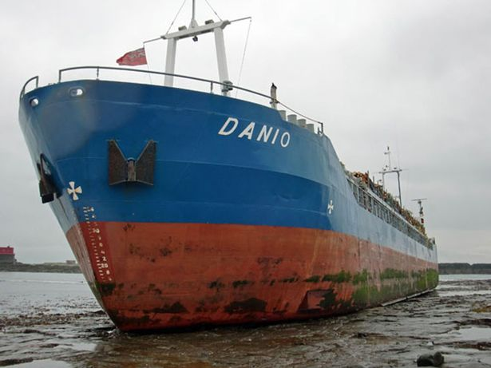
Level 3 Controls

Slide 17
Level 3 Controls
Involve the processes to detect and prevent behavioural symptoms of fatigue even though
  sufficient sleep opportunity has been given and
  supposedly sufficient sleep has been gained
These Level 3 Controls identify behavioural indicators of fatigue by the use of:
Operator monitoring technologies
Symptom checklists
Self-reporting scales
Notes:
Involve the processes to detect and prevent behavioural symptoms of fatigue as sometimes there can still be elevated levels of fatigue even though a satisfactory sleep opportunity has been given and a supposedly sufficient amount of actual sleep has been gained. This could possibly be due to factors such as sleep disorders or lifestyle factors at home. (Dawson, Chapman, et al., 2011)

Slide 18
Level 3 Controls for a Marine Pilot
 | Physical | Mental | Emotional
Generic Behaviours | Eye rubbing Yawning Slumped posture Slow blinks | Slowed reaction times Reduced Situation Awareness Poor Memory Distractibility | Irritability Terse communications Hyper-reactivity
Task specific Behaviours | Poor ship handling Delayed time to reduce speed Delayed times for course alterations | Spatial disorientation Poor anticipation Difficulties in decision making | Withdrawn Delayed response in radio communications Non-communicative
Notes:
An example of Level 3 Controls for a Marine Pilot could be that if more than three of the behaviours indicated in Table 2 (see below) are exhibited in a 15 minute period then the pilot should cease piloting as soon as possible, notify another pilot or supervisor and then undertake designated fatigue countermeasures such as napping and / or use caffeine.

Slide 19
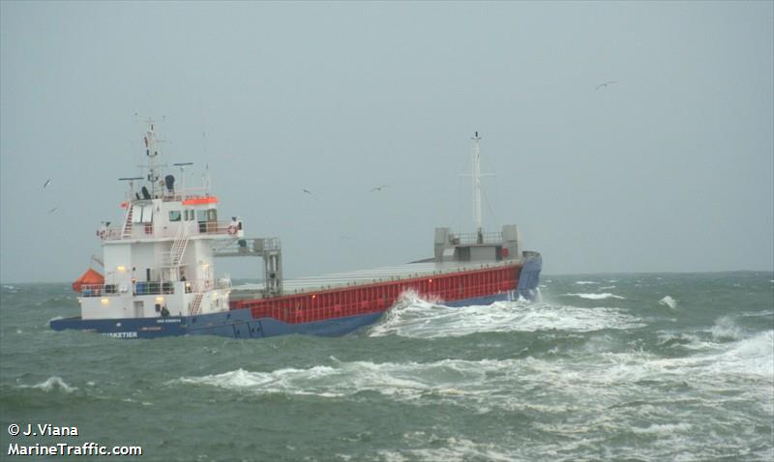
Level 4 Controls

Slide 20
Level 4 Controls
Involve processes for detecting, assessing and controlling fatigue related errors.
This is done by the use of fatigue-proofing strategies and an error analysis system.
Fatigue-proofing strategies are “adaptive and protective risk-reduction behaviours that improve the resilience of a system of work” (Dawson, Chapman, et al., 2011)

Slide 21
Fatigue Proofing Strategies
Increased supervisor/co-worker monitoring
Working in pairs
Double-check systems
Checklists
Task rotation
Additional breaks
Napping
Moving critical/monotonous tasks to daytime

Slide 22
Level 4 Control Key Objectives
They must be able to reliably recognise the indicators of fatigue-related impaired cognitive performance within the workplace.
They must be able to develop and implement formal procedures that serve to compensate for the impaired performance, thus reducing the potential for accident opportunity.

Slide 23
Pilotage Example of Level 4 Control
The use of hand signals in the appropriate direction to indicate rudder movements as well as the use of verbal commands.
These verbal commands require the helmsman to reply to the pilot to ensure that what was ordered was correct, correctly heard and correctly actioned. The pilot then needs to close this loop by glancing at the rudder indicator to ensure that this is correct.

Slide 24
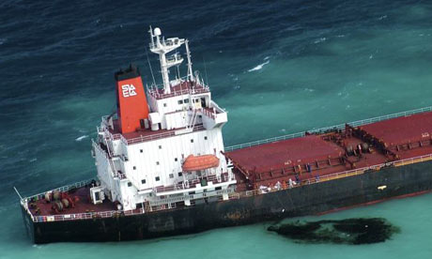
Level 5 Controls

Slide 25
Level 5 Controls
Are control mechanisms that provide feedback into system reform.
This information is used to improve identification of fatigue-related risk and help to continually update Level 1 to 4 tools.
This will enable better prevention of future fatigue-related error, incidents and accidents.
Provide potential learning opportunity and insight into how to prevent future fatigue events.

Slide 26
Summary of Fatigue Level Controls
Hazard Assessment | Incident Trajectory | Control Mechanism
Adequate Sleep Opportunity | Level 1 | Prescriptive Rules Aggregate PSW Model Fatigue Modelling
Adequate Sleep Obtained | Level 2 | Personal PSW Model
Fatigue Related Behaviours? | Level 3 | Behavioural Audit Symptom Checklist
Fatigue Related Errors? | Level 4 | Error Analysis Addresses Levels 1 – 3
Fatigue Related Incidents? | Level 5 Actual Incident | Incident Analysis addresses levels 1 -4

Slide 27
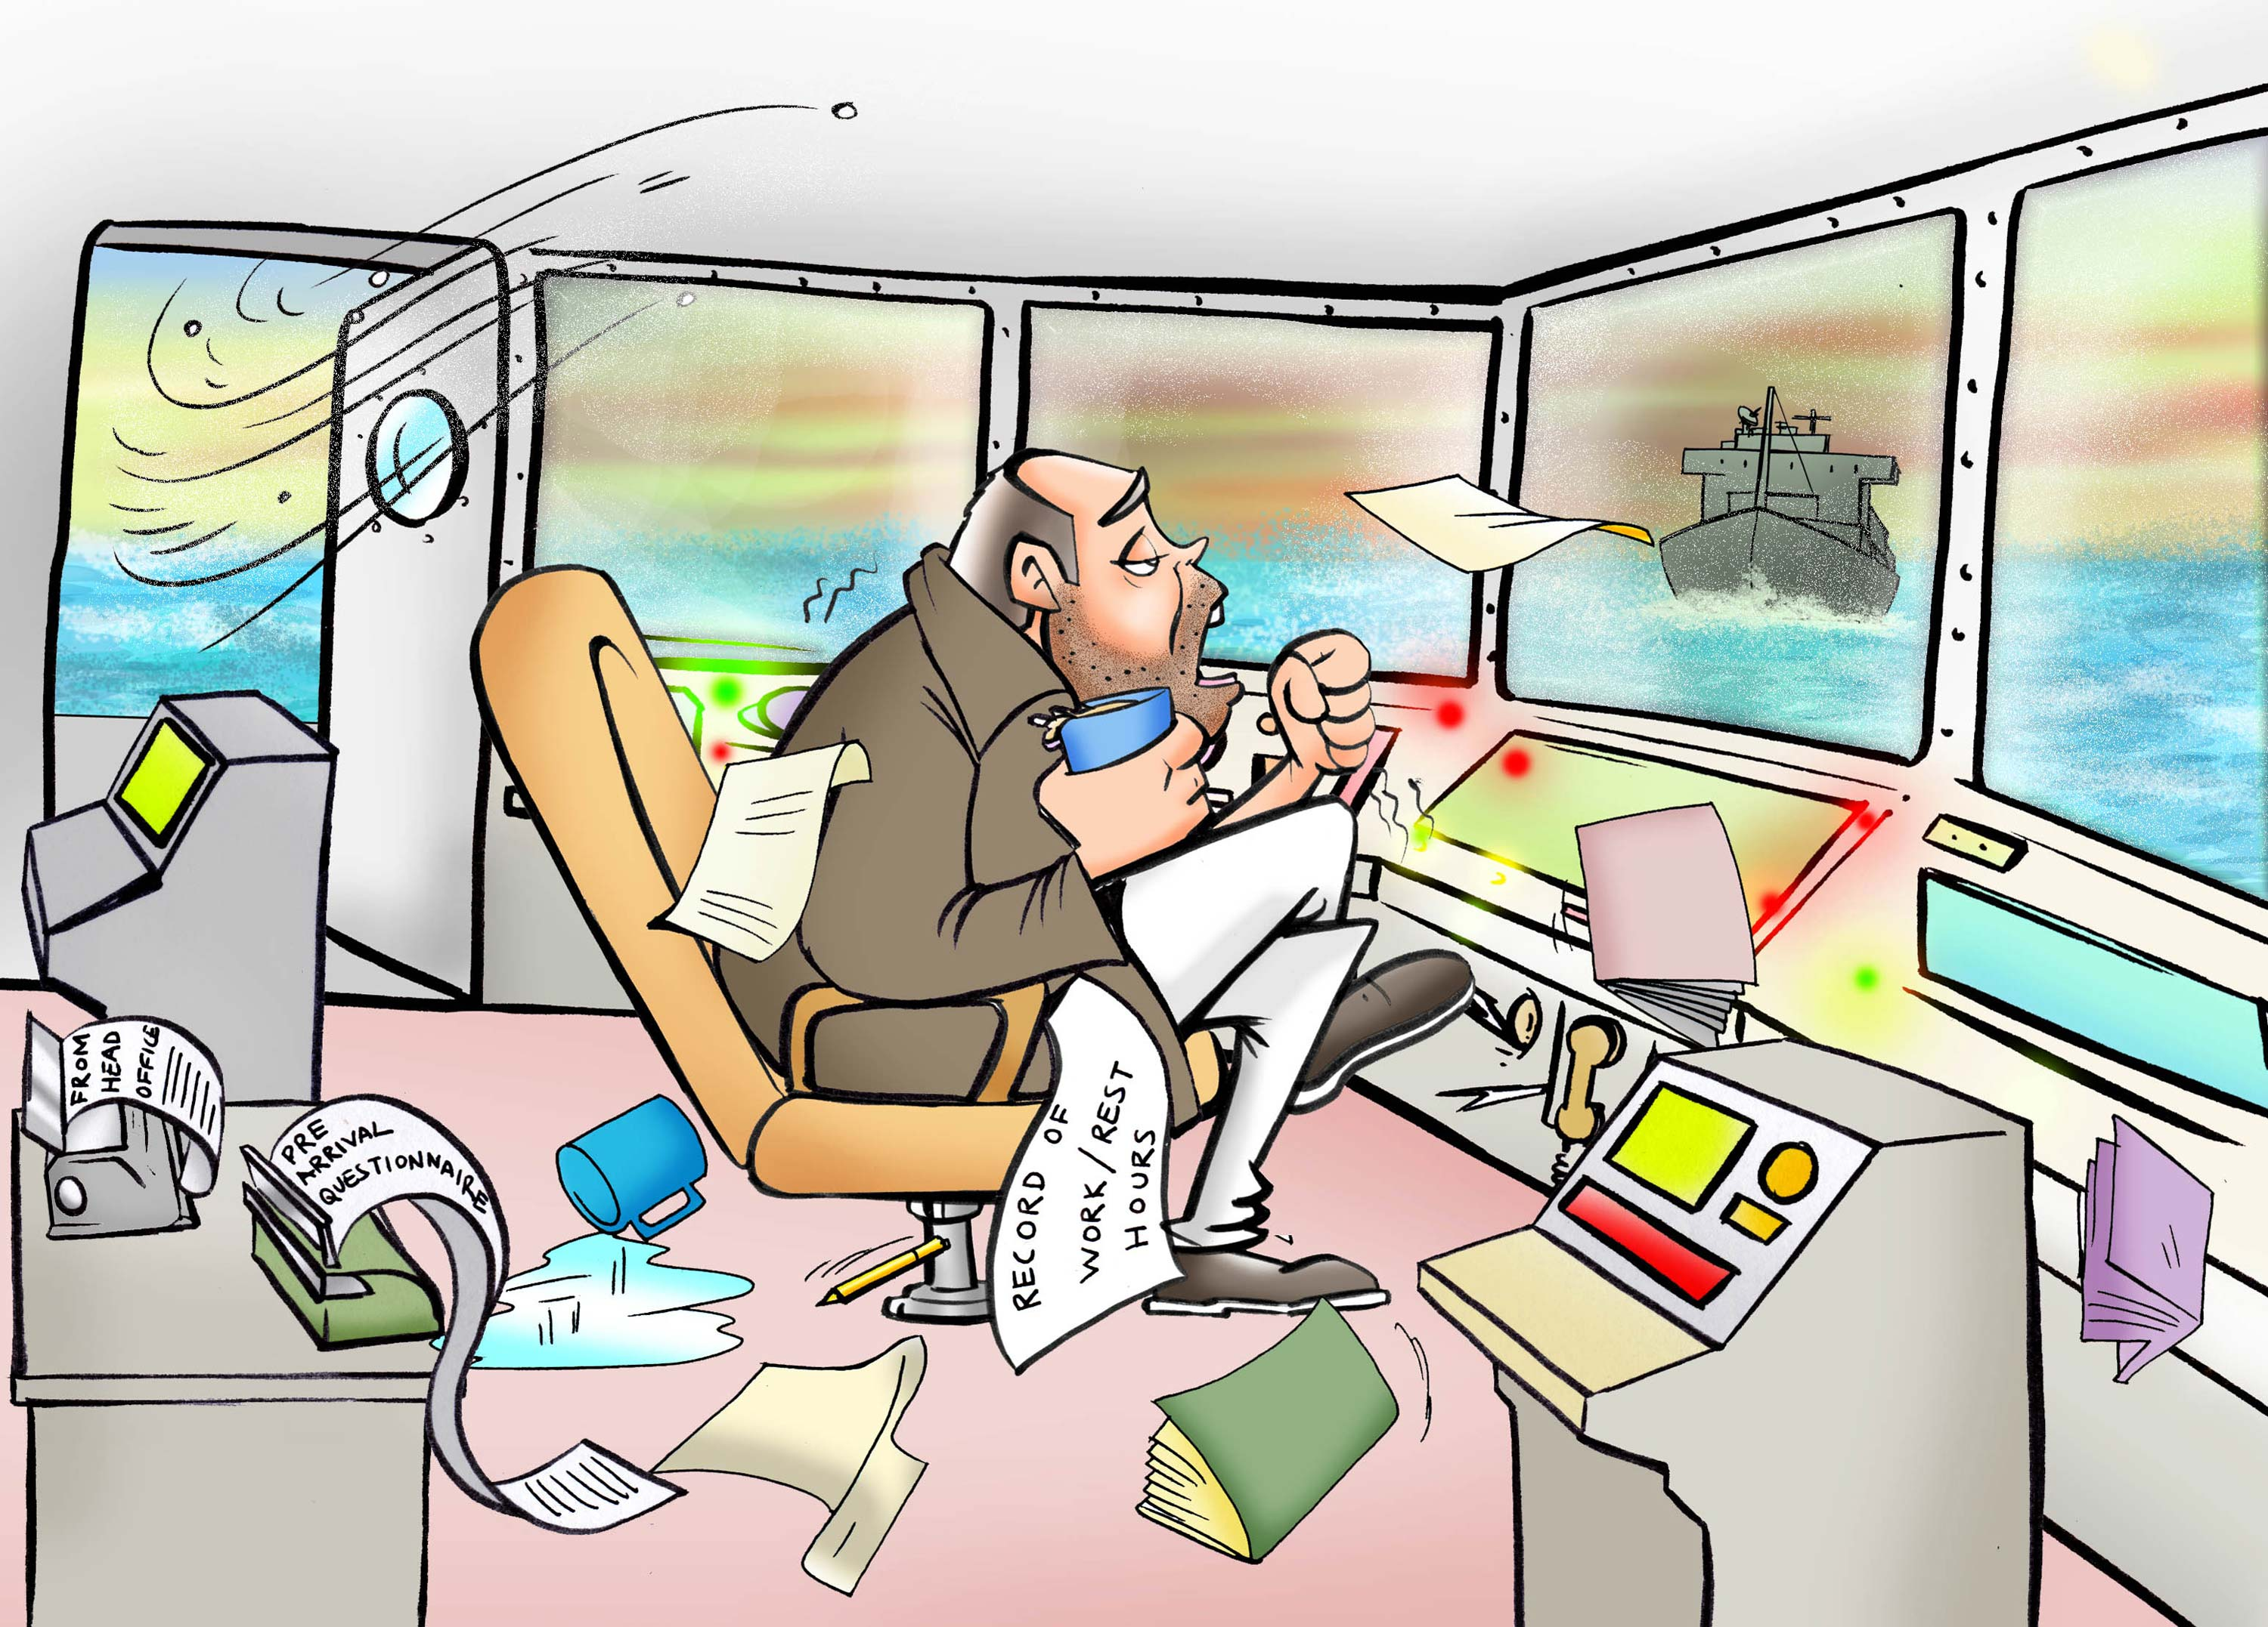

Slide 28
IMO Fatigue Guidelines
It has been realised that the current IMO Guidelines are not sufficient in todays risk based work place.
Effectively dealing with fatigue in the marine environment therefore requires a holistic approach.
The guidelines therefore are undergoing a transformation (led by Australia, with help from other countries) with the aim to provide the latest fatigue information in a readily accessible format.
These Guidelines are intended to be a living document which will be updated periodically as scientifically validated research reveals new information and new methods are uncovered to deal with the issue of fatigue.
Notes:
MLC 2006 Hours of Work will work in conjunction with the new fatigue guidelines – Prescriptive allied with risk based methods.

Slide 29
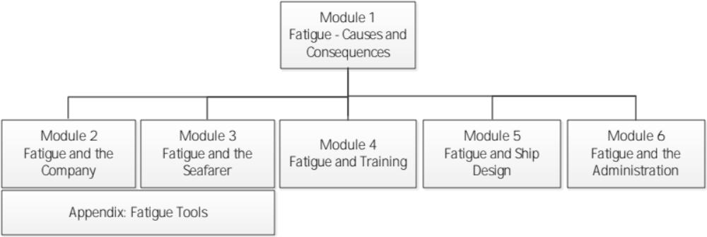
IMO Fatigue Guidelines

Slide 30
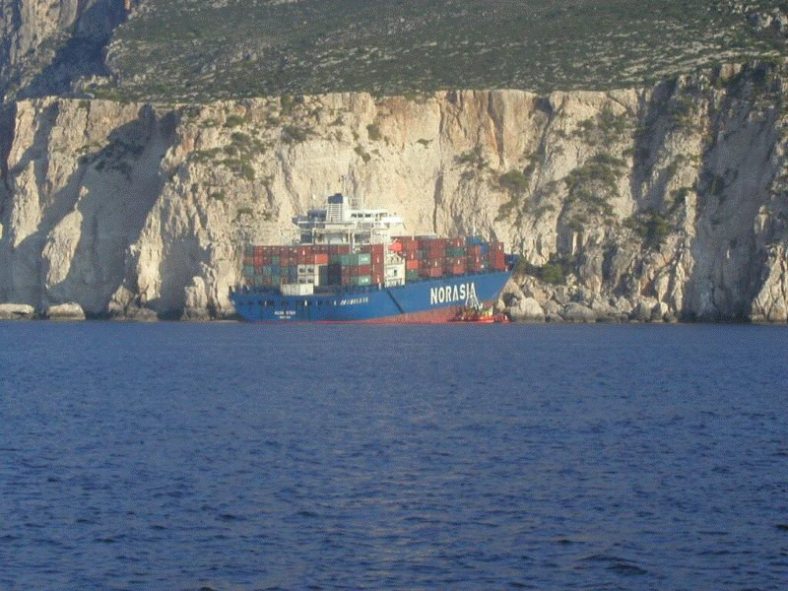
The End

